Slide 1
Apache Superset Mapping Plugins
The Innovators Alliance
Notes:
Hello, welcome to our presentation for Group 11, otherwise known as the innovators alliance. We are very excited to showcase our progress on creating a mapping plugin for apache superset.

Slide 2
Introduction: Our partner
Partner: Evan Wheeler, chief technology officer at UNICEF's Global Innovation Centre.
UNICEF works in the world’s toughest places to reach the most disadvantaged children and adolescents. The organization is also the largest provider of vaccines, nutrition, safe water and sanitation, quality education.cation

Slide 3

Introduction to Apache Superset
Modern, enterprise-ready business intelligence web application
Intuitive User Interface
Connectivity to Various Data Sources
Data Exploration and Analysis
Extensibility and Integration

Slide 4
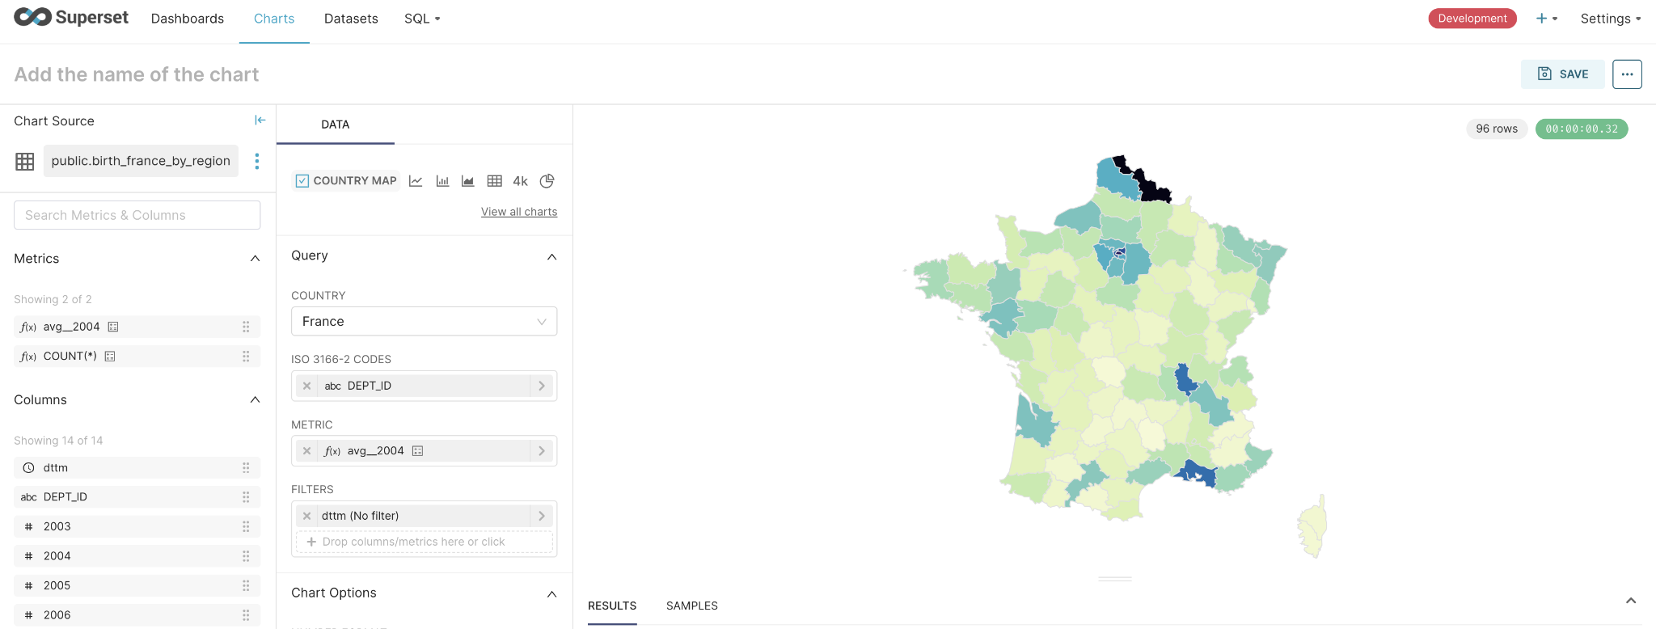
Main problem: Existing Solutions

Slide 5
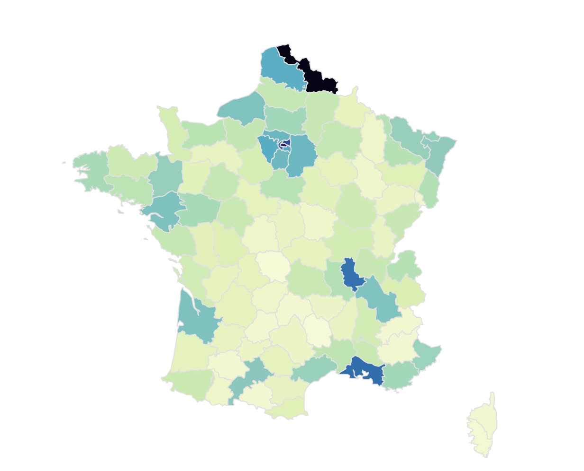
Main Problem: Existing Solutions
- Pre-built/Static data
Uses a static, prebuilt set of data describing geographical boundaries.
- Limited visuals
Only shows the boundaries of the country, not the surroundings of the country
- Insufficient support
Existing map plugin does not support most of the countries UNICEF operates and is deprecated

Slide 6

Our Product Description
- Visualizes population, GDP and other data over various countries.
- Visualizes surrounding geographical boundaries
- Integration with real-time data or satellite imagery (Aiven)
- Follows Apache Superset's new approach for plugins (Javascript, React.js)
Notes:
Our product takes in data for population, GDP, and geospatial information important for distinguishing different regions of countries. This design visualizes the data into an easy to understand map that shows the different regions along with the data being requested. It is integrated with real-time data through Aiven, an open-sourced data cloud used to build data infrastructure.

Slide 7

Primary Stakeholders
UNICEF personnels
Government personnels
Clients wanting to visualize data over geographic locations.
Notes:
This plugin was built specifically for UNICEF personnels to work with Apache Superset, but it will also be open-sourced meaning anyone can use it. We predict that it could be useful for government personnels and other clients.

Slide 8
User Stories
- As a UNICEF personnel, I want to use this plugin in order to navigate a population heat map, allowing different data sources to be interpreted by the map.
- As a Government Personnel, I want to use this plugin in order to clearly identify the differences between districts and states in a given region.
- As a humanitarian project manager, I want to a visual representation of populations in different regions of various countries
Notes:
Our user main user stories are the following:

Slide 9
Plugin Showcase
Notes:
- Now, I will showcase how our plugin works. In the demonstration, I will visualize the map for different data of 3 countries that were previously not found in the old country map.

Slide 10
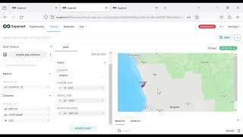

Slide 11
Architecture and Technical Discussion
Frameworks/Languages : Flask Backend, React (TS), Apache Superset, Postgres.
CI/CD + testing : CircleCI + jest
Database: Remote Postgresql db (though Apache superset supports a wide variety of relational database types.)

Slide 12
Internal flow
Maps the response from data request to props that will be passed to the chart viz component.
Function that builds the query which will be sent to the endpoint to retrieve data for chart
Configuration for the control panel that users interact with to make chart
buildQuery.ts
transformProps.ts
ControlPanel.ts
Once we have the props and configuration, how do we display the chart?
MapPlugin.ts
index.ts (MapBoxPlugin)
Extends ChartPlugin
Addition info regarding chart (name, credits, desc, etc)
metadata

Slide 13

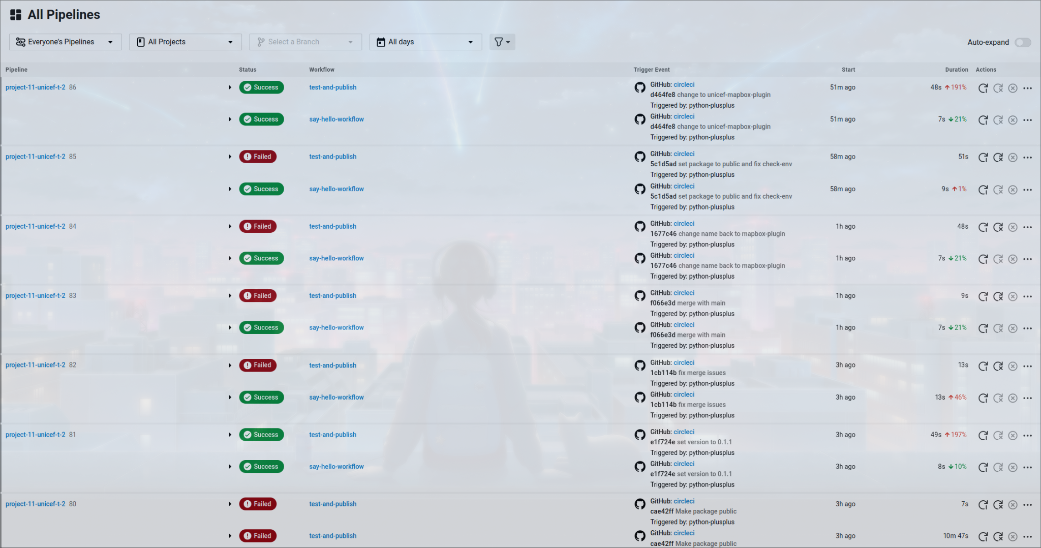
CI/CD Pipeline & Tests
Jobs:
-say-hello
-check-env
-node/test
-publish
Unit testing UI/visual components is cumbersome and expensive when running everytime on the CI/CD pipeline. Think Mocha? Also, asynchronous functionality is very limited within the superset plugin library.
What can we test?
-index.test.ts
Is the plugin functional?
-buildQuery.test.ts
Can we get a reliable way to transform the formdata into a request?
-transformProps.test.ts
Are we giving the chart the kind of data that it needs?
Workflow:
Is CircleCI properly configured?
say-hello-workflow
say-hello
Are the environment variables set? E.g. npm API key
Run the jest tests on the package.
Verify that package.json has new version specified and push to npm.
test-and-publish
check-env
node/test
publish

Slide 14
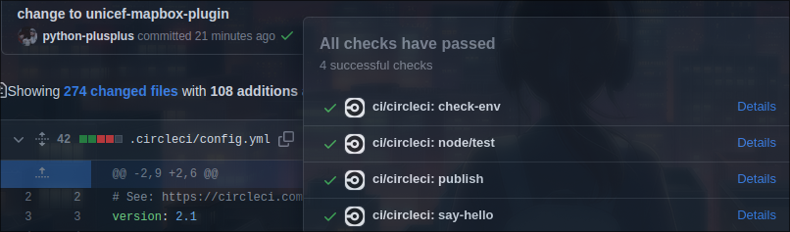
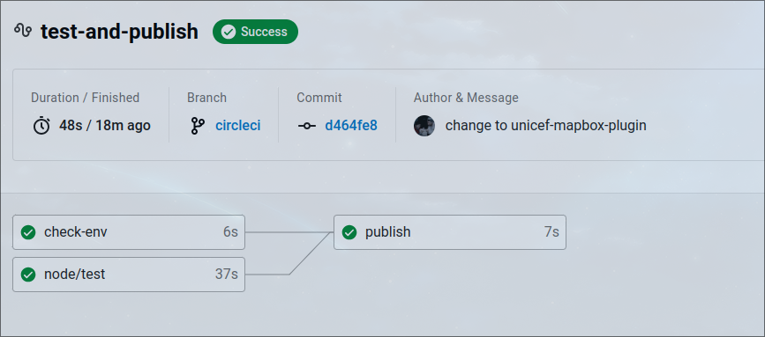
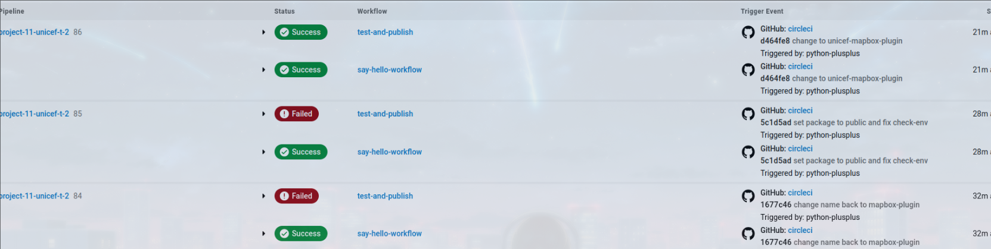
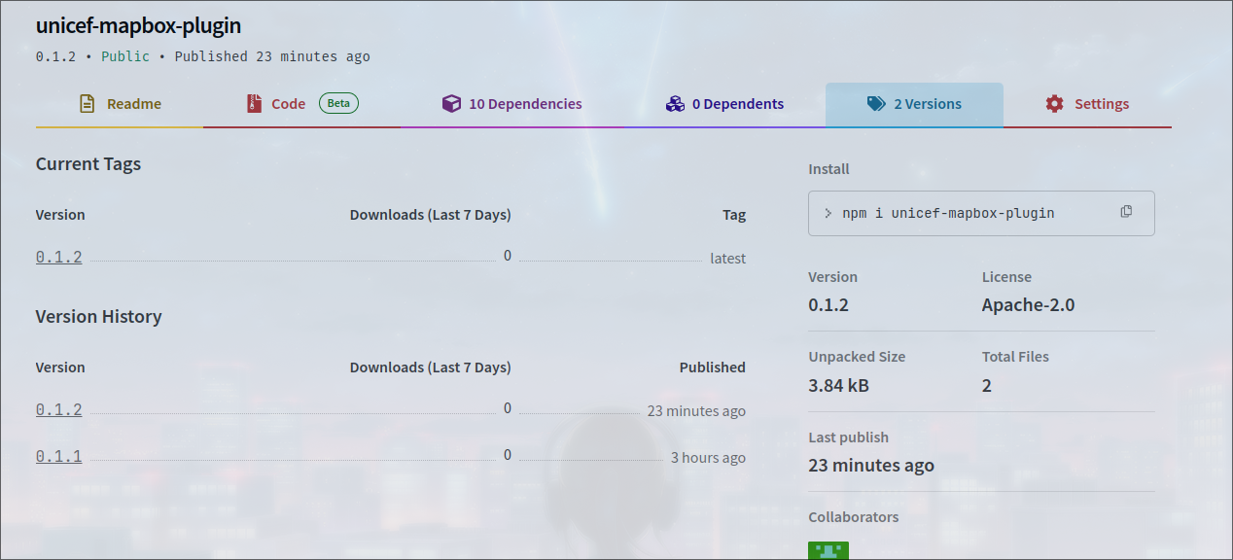
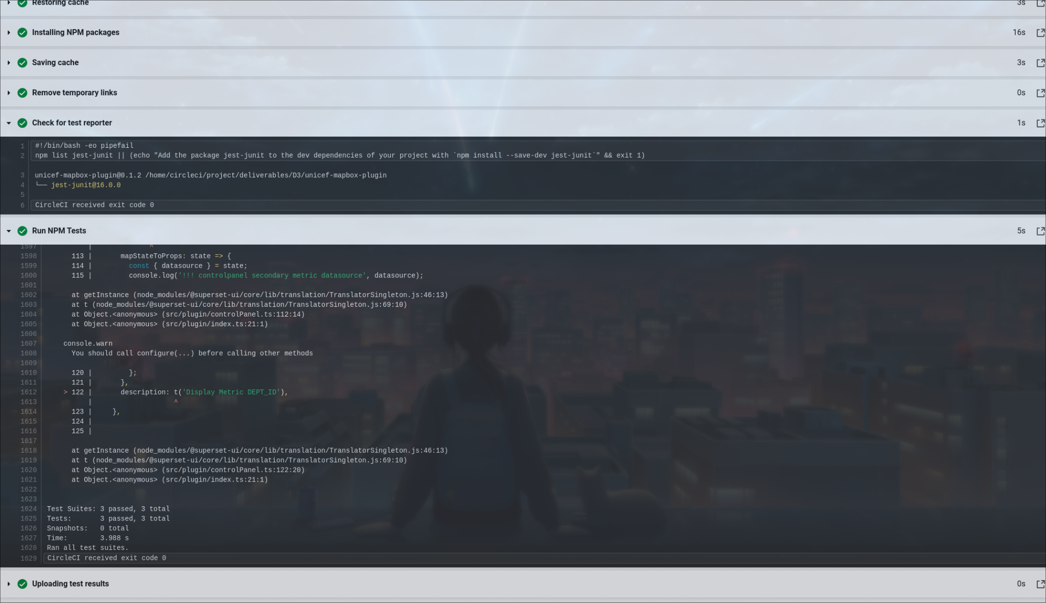

Slide 15
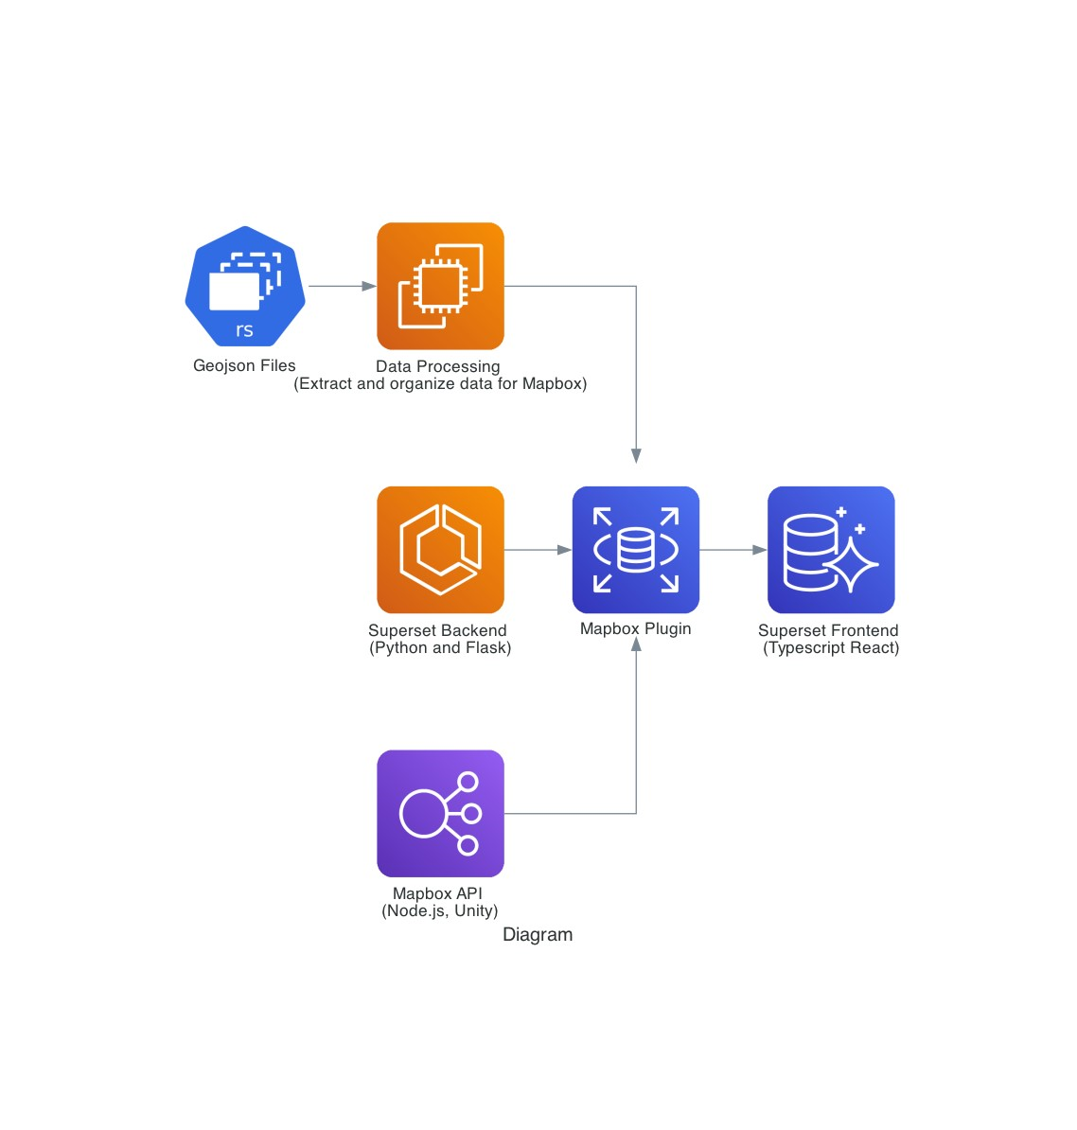
External flow

Slide 16
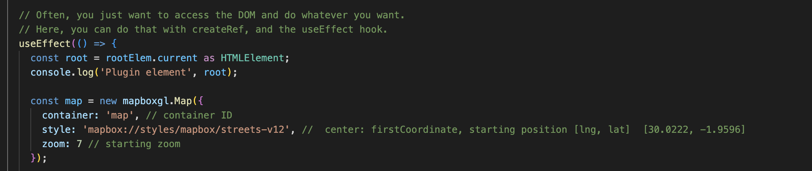
Architecture and Technical Discussion
Proper Documentation: Created comments for readability
Used ESLint and Prettier to ensure proper coding practices

Slide 17
Process & Deployment
Plugin Deployment:
Create a release in Github (Open Source)
Configure Superset. Install Dependencies.
Integrate into Superset by following instructions or running our scripts.
Simplified deployment: Dockerization with Docker Desktop for the OS.
Working Together:
Weekly Meetings on Thursday & Friday
Online and In-Person (Bahen Centre)

Slide 18
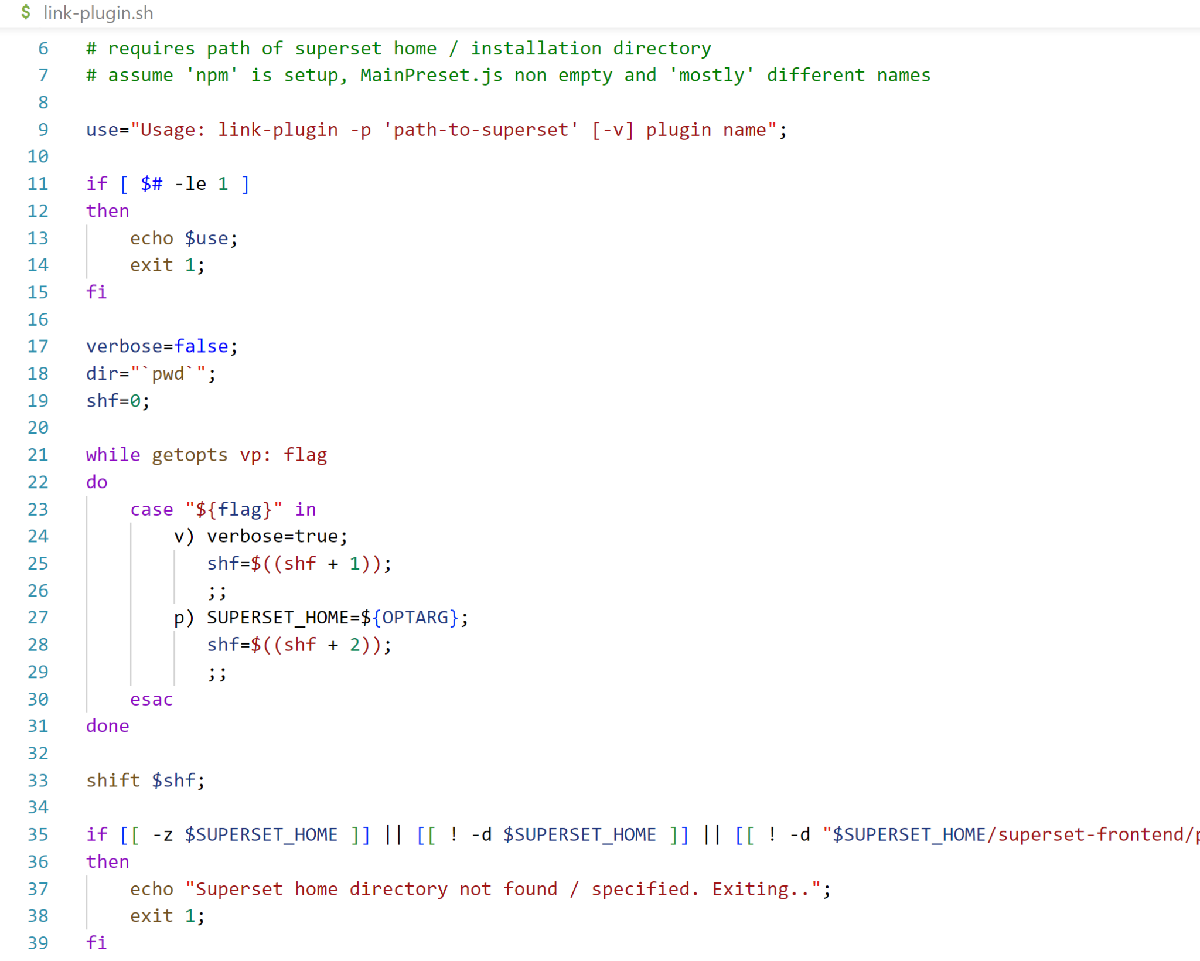
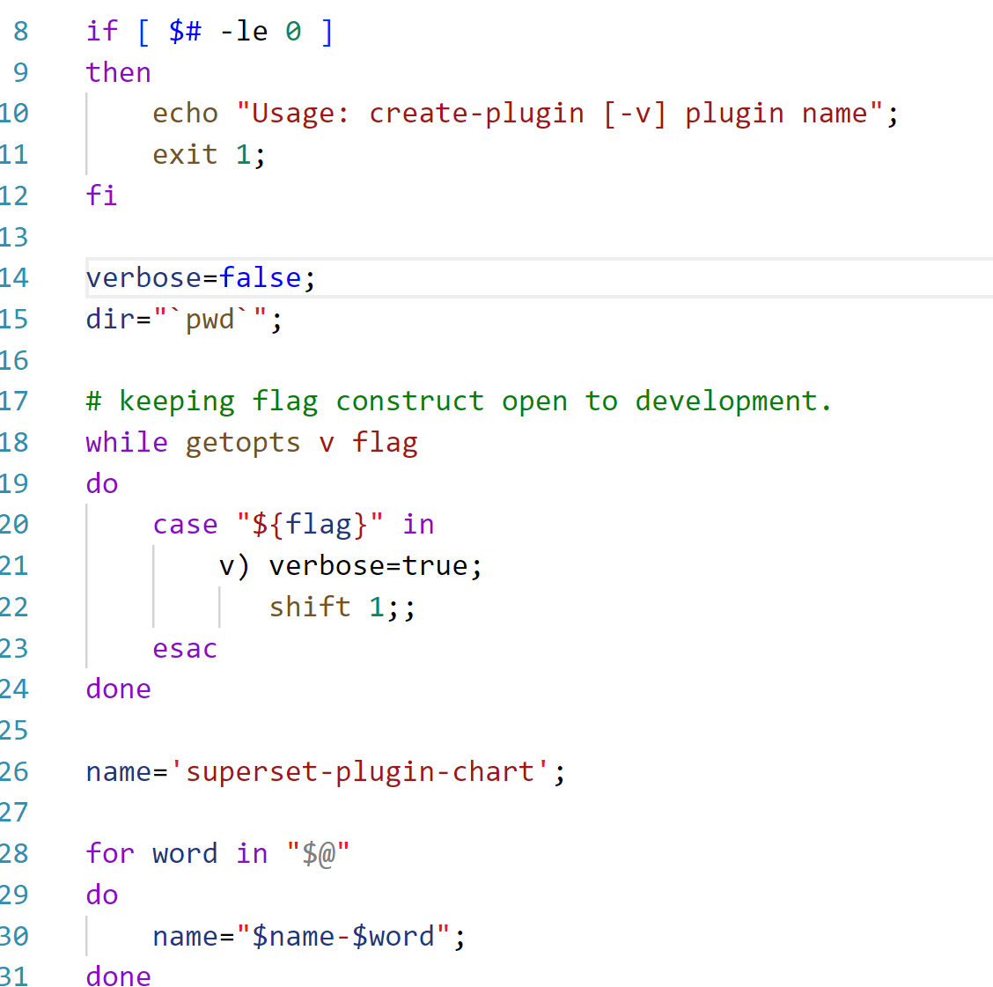
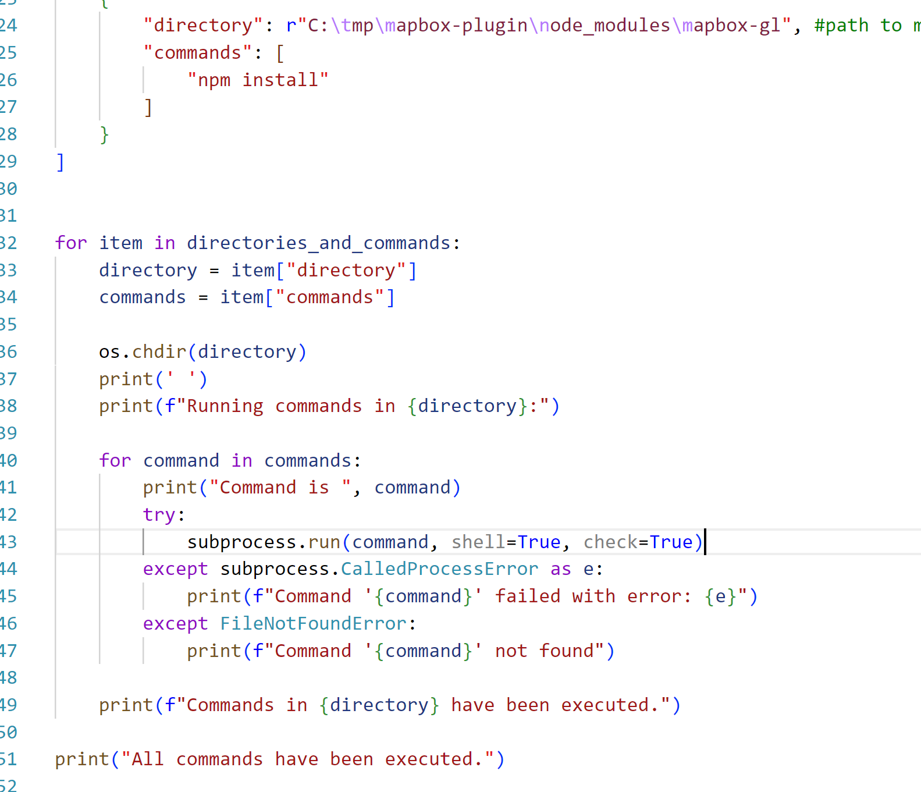
Accessing Our Application: Scripts
Linux
Linux
Windows
Notes:
Show documents we made about how to use the plugin, script/readme

Slide 19
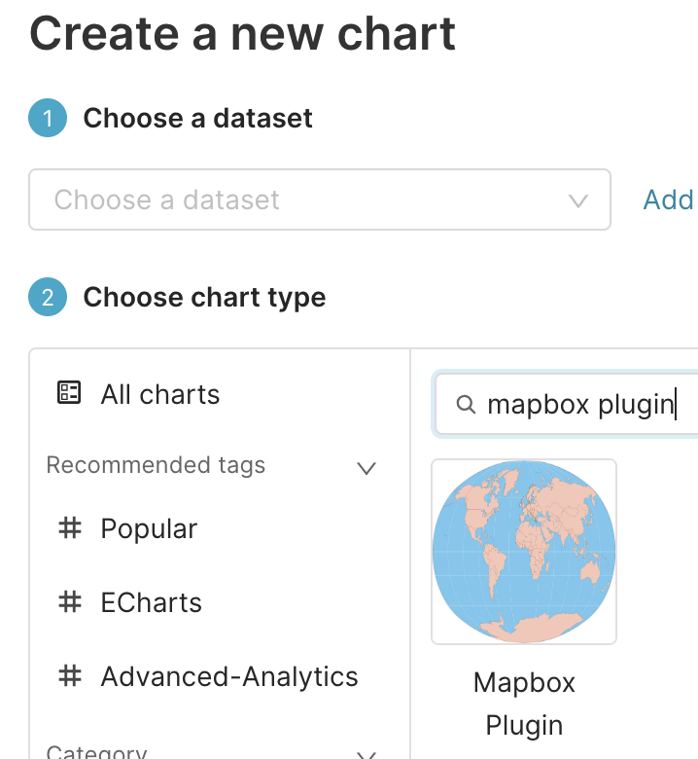
Accessing Our Application
Access:
Users access plugin in the Superset application
Handing Off:
Github repo can be accessed by UNICEF (it is open sourced)
Login info to our logging and pipeline software (CircleCI) will be given
Publicly available on npm as unicef-map-plugin
README contains detailed instructions
Simplified deployment:
Dockerization with Docker Desktop for Windows

Slide 20
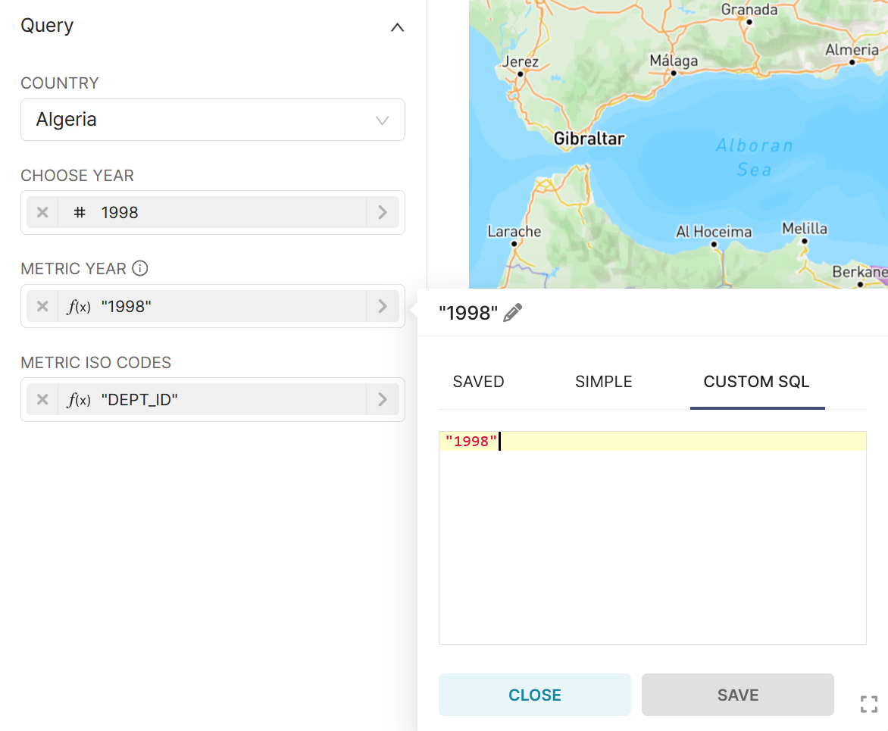
Things to improve
Add more options to control panel
- Color Scheme, Filtering, Hovering Feature
Modify Custom Metric Options
- Currently requires user to manually type a Custom SQL to select the correct column from dataset

Slide 21
Reflection & Key Learnings
Be realistic with your plans:
We had many ideas of different things we could implement but after many roadblocks, we settled on a more attainable goal
Technical Difficulty:
Superset has a high point of entry in terms of technical skills
Superset is hard to setup and deploy successfully
Configuration for different OS systems are all different and confusing

Slide 22
Reflection & Key Learnings
Agile Methodology:
Agile approach: Breaking up the project into smaller parts
Increased efficiency and less collisions between teammates' PRs.
Customer Demands:
Sometimes customer does not know what they want until they see the final product.
Our partner suddenly asked for modifications to the current control panel, a request not previously discussed in our meetings.

Slide 23
Individual Contributions
Jianxiang Ma: Assisted in creating the mapbox plugin by editing GeoJSON files & adding country data. Created a python script to extract useful information from GeoJSON files
Parth Singh: Found solutions to keep Apache Superset working in Development mode (Linux primarily), discovered and verified live bugs for running Docker on WSL 2 engine on Windows, simple tests for plugin backend functions, made automation scripts for barebone plugin creation, plugin building, docker verification & controls.

Slide 24
Individual Contributions
Justin Zeyong Zheng: Created the main visualizations of the map plugin. Integrated Mapbox-Gl with Apache Superset to create the map. Created code to query database to display a heatmap of data over geographical regions.
Kuan-Lin Kuo: Assisted in creating the mapbox plugin by editing GeoJSON files & adding country data. Created and integrated avien cloud database for uploading data.
William Jarvis-Cross: Added country population and geospatial data through geojson files. Devops work to keep work organized including adding linting and code formatting tools.

Slide 25
Individual Contributions
Sunny Kim: Set up configuration files and automated npm deployment via CI/CD pipelines using CircleCI.
Vala Jalalvandi: Added QOL features to the plugin in order to provide information in a more digestible way. (ex. Card view for data points)

Slide 26


